Slide 1
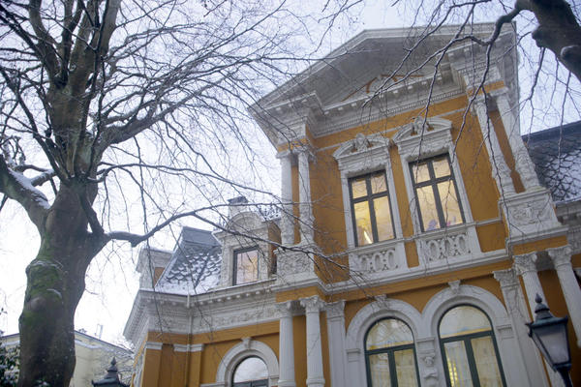
Centre for the Study of the Sciences & the Humanities (SVT), University of Bergen (UiB), Norway
THE MANY VOICES OF KNOWLDGE
Silvio FUNTOWICZ
@SFuntowicz

Slide 2
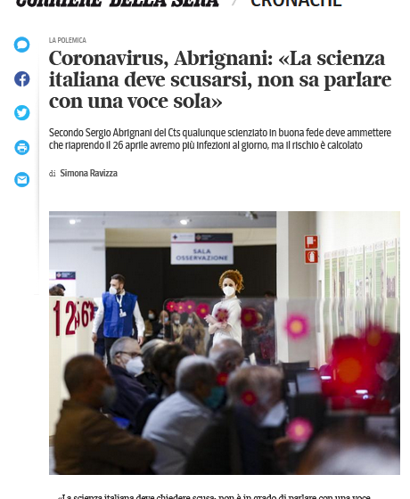
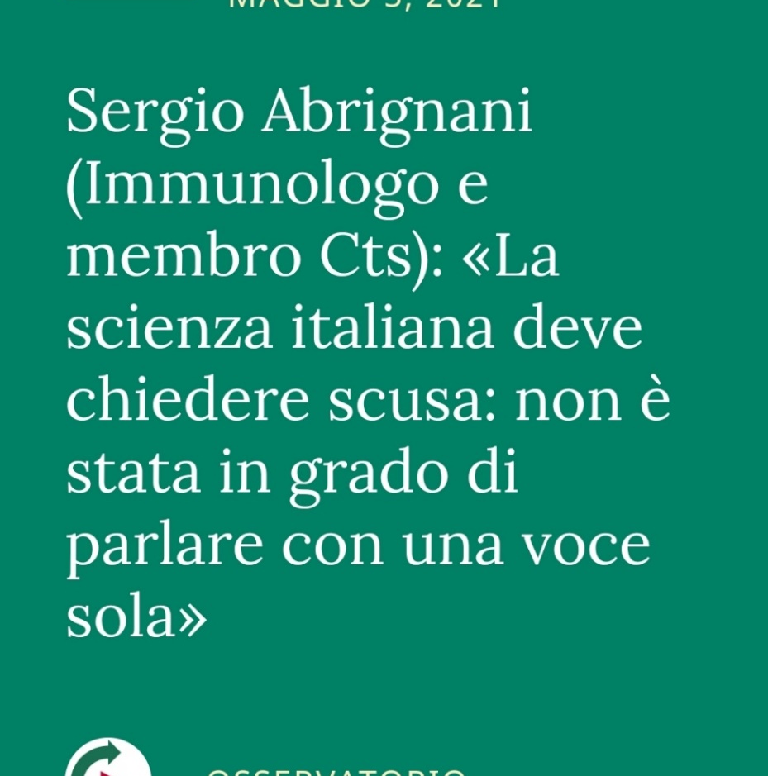
Corriere della Sera 05/01/2021

Slide 3
(Sir) David Spiegelhalter, chair of the University of Cambridge Winton Centre for Risk & Evidence Communication
Times Higher Education, September 3, 2021
“The science doesn’t tell you what to do, so how can you ever follow the science?
“how can [following the science] be true when apparently the same science produces dramatically different opinions among scientists about what should be done?”
“So I think that terrible phrase…gives the wrong impression of what science contributes [to the debate]” and also “encourages the image that ‘Oh well, if I know the science, I know what to do.’”
https://www.timeshighereducation.com/news/spiegelhalter-scientists-straying-too-far-policy-advocacy

Slide 4
1987, Pion
https://library.mpib-berlin.mpg.de/toc/z2009_1891.pdf

Slide 5
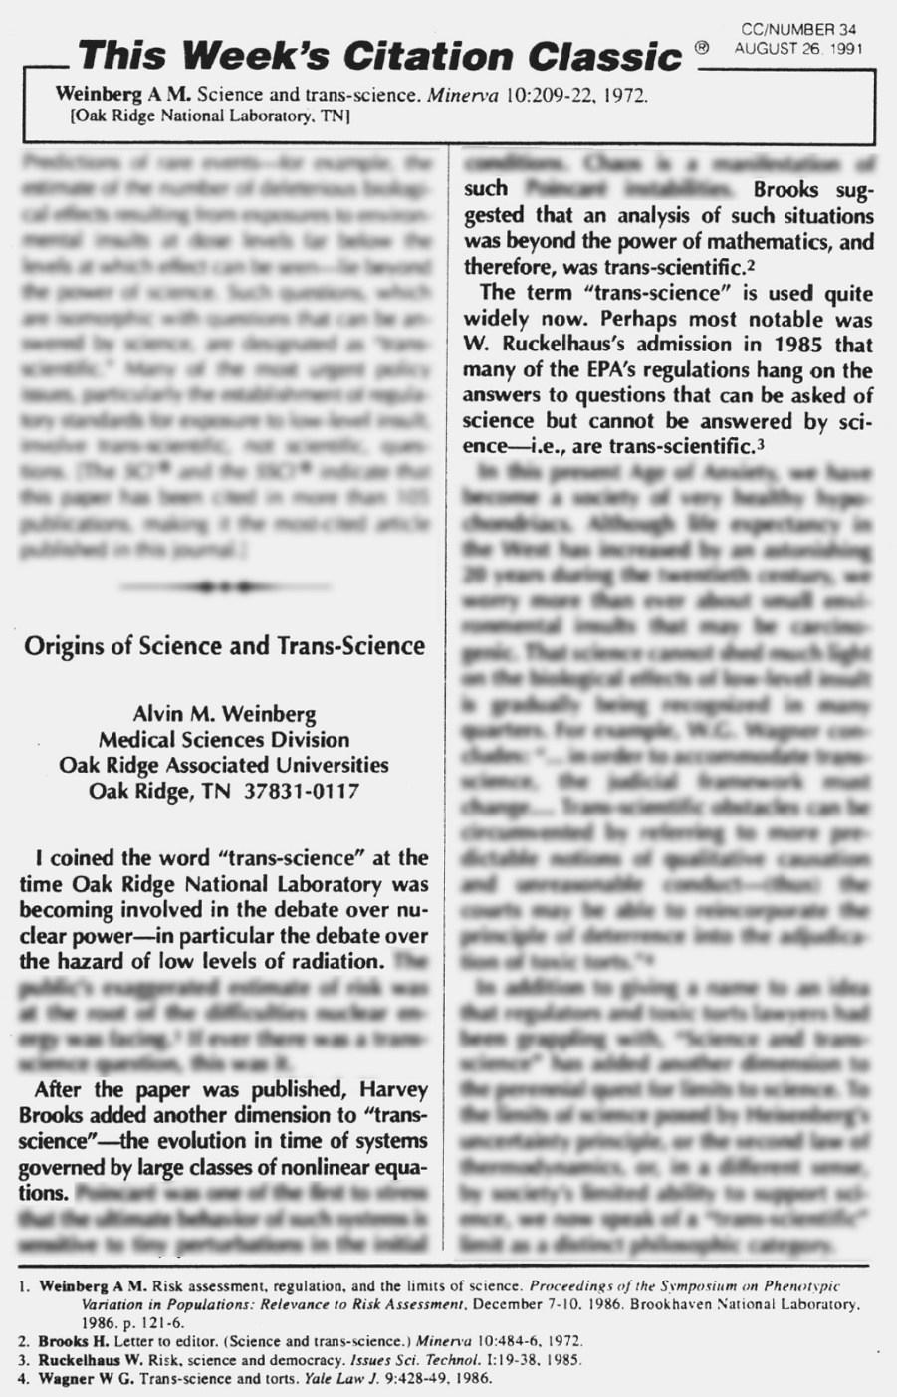
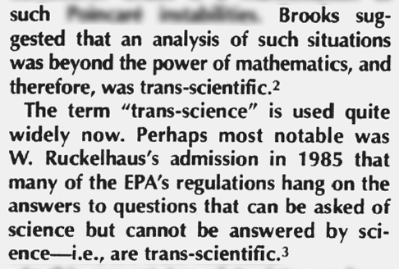
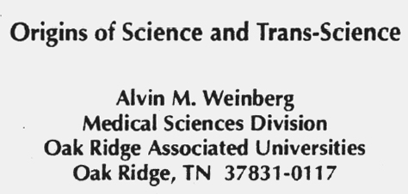
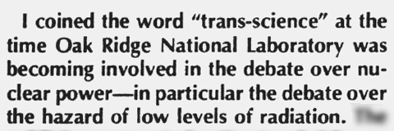
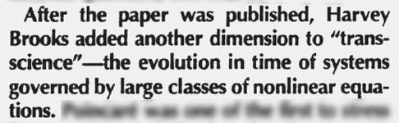
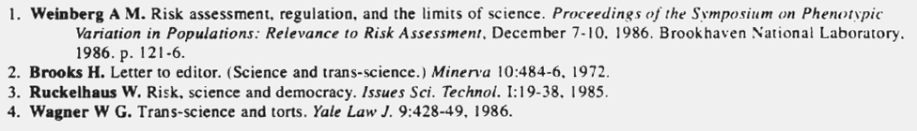
Notes:
The Impossibility of Proving Impossibilities, Harvey Brooks, Herbert Spencer Lecture, April 14, 1976

Slide 6
[…] EPA’s science panel found that “quantitative evidence […] must … be characterized as having high uncertainties.” What to do in the face of uncertainty is a policy question, not a scientific question. [..] The debate is about […] what kinds of uncertainty can be tolerated as a basis for decision-making.
Hazy reasoning behind clean air David Goldston, Nature 452|3, April 2008
‘Science alone can’t determine how regulations are written’

Slide 7
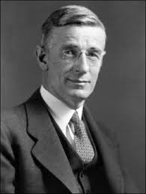
Vannevar Bush
(1890-1974)
‘Science”the Endless Frontier’
by Vannevar Bush, 1945:
“One of our hopes is that after the war there will be full employment. […] To create more jobs we must make new and better and cheaper products […] founded on […] basic scientific research. […the] Government […] opened the seas to clipper ships and furnished land for pioneers. Although these frontiers have more or less disappeared, the frontier of science remains.”
Bush, V. (1945) Science: the endless frontier, United States Office of Scientific Research and Development, U.S. Govt. print office.
Slide by Andrea Saltelli

Slide 8
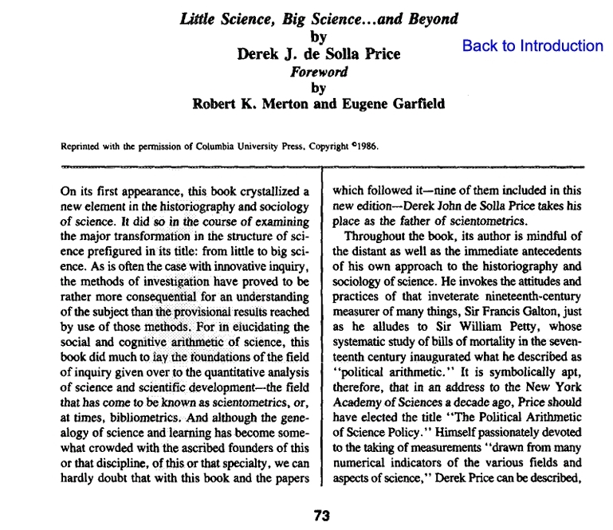
Big Science
Weinberg, Alvin 1961. "Impact of Large-Scale Science on the United States". Science. 134.
1963

Slide 9
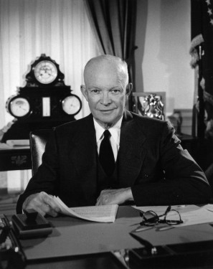
Eisenhower's Farewell Address to the Nation January 17, 1961 http://www.informationclearinghouse.info/article5407.htm
Today, the solitary inventor, tinkering in his shop, has been overshadowed by task forces of scientists in laboratories and testing fields. In the same fashion, the free university, historically the fountainhead of free ideas and scientific discovery, has experienced a revolution in the conduct of research. Partly because of the huge costs involved, a government contract becomes virtually a substitute for intellectual curiosity. For every old blackboard there are now hundreds of new electronic computers.
The prospect of domination of the nation's scholars by Federal employment, project allocations, and the power of money is ever present – and is gravely to be regarded. Yet, in holding scientific research and discovery in respect, as we should, we must also be alert to the equal and opposite danger that public policy could itself become the captive of a scientific-technological elite.

Slide 10
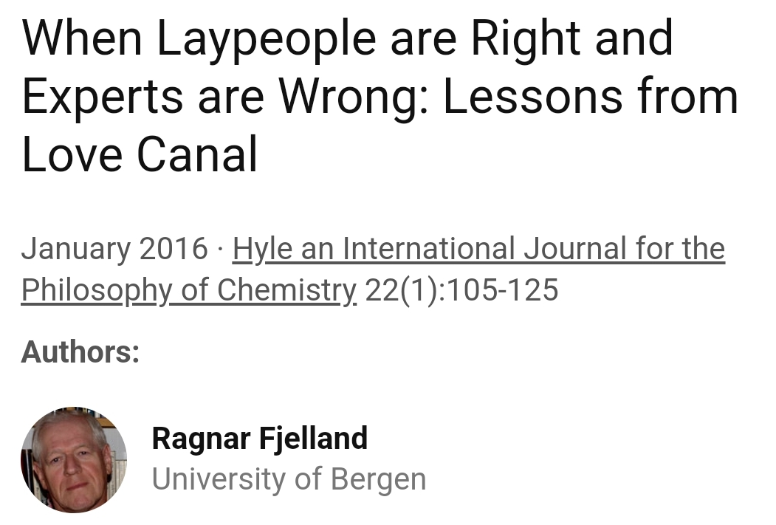

Slide 11
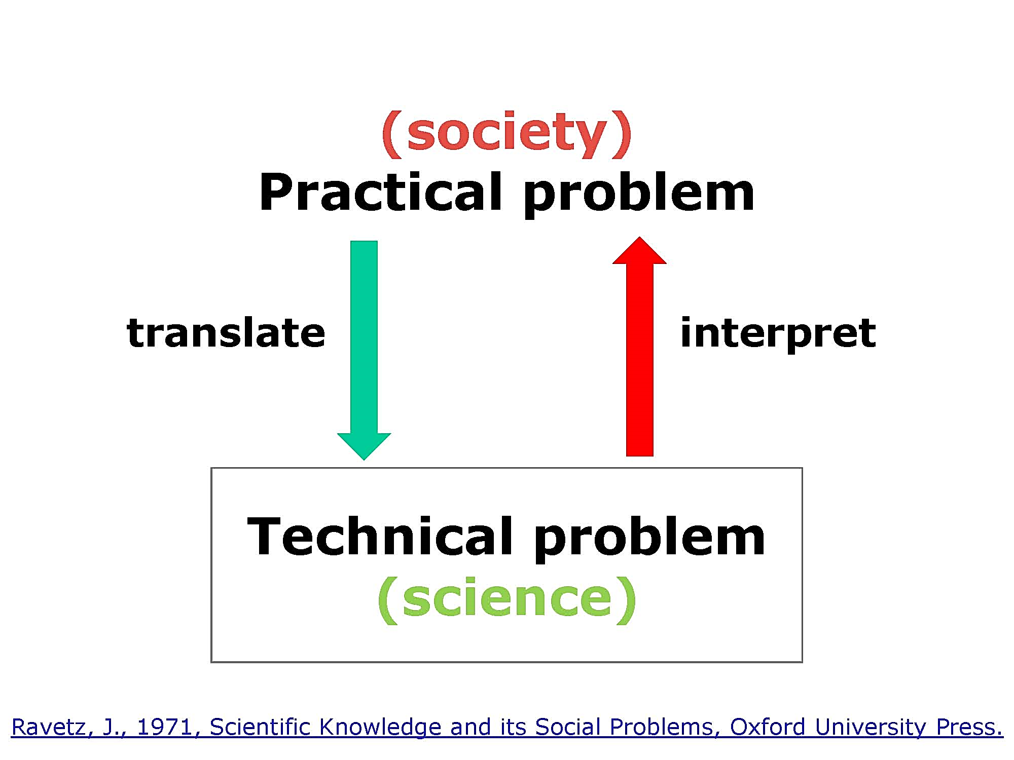
Slide by Jeroen van der Sluijs

Slide 12
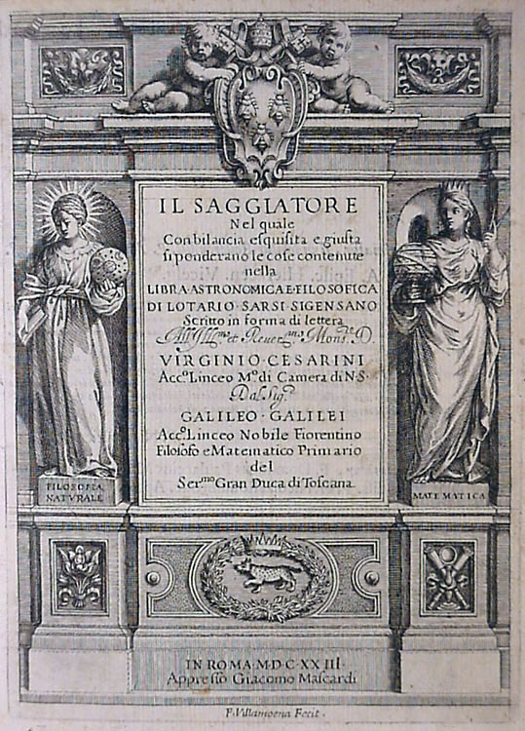
Galileo: primary and secondary qualities
… a piece of paper or a feather, when gently rubbed over any part of our body whatsoever, will in itself act everywhere in an identical way; it will, namely, move and contact. But we, should we be touched between the eyes, on the tip of the nose, or under the nostrils, will feel an almost intolerable titillation – while if touched in other places, we will scarcely feel anything at all. Now this titillation is completely ours and not the feather's, so that if the living, sensing body were removed, nothing would remain of the titillation but an empty name. And I believe that many other qualities, such as taste, odour, colour, and so on, often predicated of natural bodies, have a similar and no greater existence than this.
Galileo Galilei (1623): The Assayer

Slide 13
COMPLEXITY AS A SYSTEM PROPERTY
ROBERT ROSEN
International Journal Of General System, 3:4, 227-232,1977
Complexity is generally viewed as an intrinsic property of certain kinds of systems, or at least, as a property of a specific description of such systems. The view towards complexity taken in the present note is different; namely, that complexity reflects the necessity for many distinct modes of description of a system. This in turn depends upon the number of ways we can effectively interact with a system

Slide 14
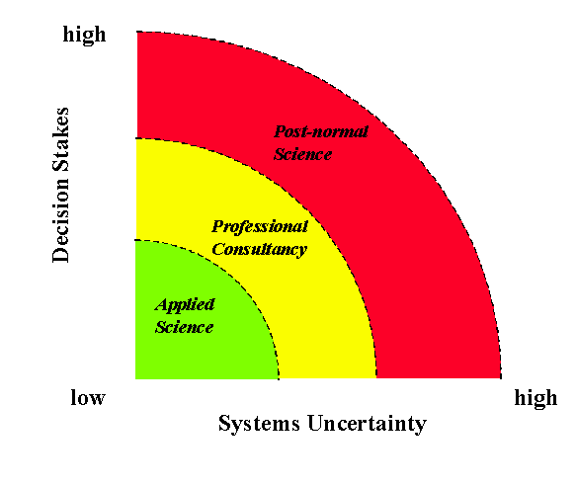
Mantra:
- facts uncertain,
- values in dispute,
- stakes high, &
- decisions urgent
Wikipedia: Post-normal science, NUSAP, Jerome (Jerry) Ravetz & Silvio Funtowicz

Slide 15
Not only Covid
Climate change
Ecosystems collapse
Biodiversity loss
Sustainability transitions

Slide 16
Context
Intolerable inequalities (social, economic, …)
Weak democratic institutions
Authoritarian tendencies
Magical idea about the role of Science in Society

Slide 17
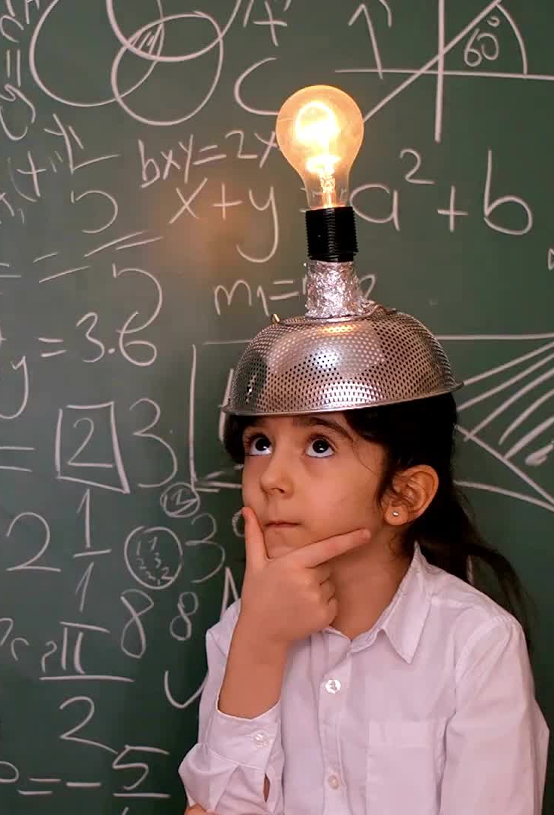
From Orchestration of Disciplines to
Choreographies of Knowledges
We are now aware that Science doesn’t speak with one voice
We have yet to learn that Knowledge doesn’t speak only the language of Science
Notes:
Brunelleschi & the Florence Cathedral dome (1420-1461) perspective
John Harrison (1693-1776) Longitude. Scilly naval disaster of 1707
Ignaz Semmelweis 1846 Vienna hospital, washing hands.

